Slide 2
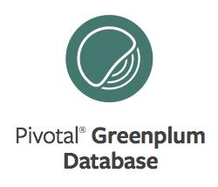
GPDB Table Partitioning
Notes:
Intro: my name is, my role is, …

Slide 3
Agenda
Introduction
What is table partitioning?
Two methods of partitioning
Why partition?
Steps to partition a table
Test it out in the lab
Notes:
Table partitioning allows you to break your tables into consumable pieces that can improve performance during table scans.
Upon completion of this lesson, you should be able to:
Describe table partitioning in the Greenplum Database.
Identify the two methods available for partitioning a table.
List the reasons for implementing table partitioning.
Identify the steps you use to partition a table.
Also, include from Best Practices Guide

Slide 4



Historical Data Management
Rolling 13 months
Months older than 13 months cycles to the next stage
Recent month
Jan 2010
Feb 2010
Mar 2010
Feb 2011
Apr 2010
Jan 2000 –
Dec 2009
May 2010
Jun 2010
Jul 2010
Aug 2010
Sep 2010
Deep history
Oct 2010
(this can be HDFS)
When a new month starts, current month cycles to next stage
Nov 2010
Dec 2010
Jan 2011
Notes:
Let’s begin by considering how table partitioning, combined with a couple of other GPDB storage features, provides a powerful Information Lifecycle Management, or “ILM”, solution. This example shows a large, partitioned, fact table, tracking transactions back to January 2000. The current month is “live”, and its data is stored in a row-oriented partition, which is defined on a tablespace which links to an SSD-based filespace. Queries against this partition are extremely reponsive, and may include INSERT, UPDATE, and DELETE, in addition to SELECT. The previous month’s data, along with data going back on year, is housed within Append-Optimized, columnar partitions, defined within a tablespace tied to SAS disks. This portion of the data is optimized for the type of reports the organization needs to run against data for the past year. Older, “deep history” data, is stored on an adjacent Hadoop cluster, within a partition defined as an external table, using the “gphdfs” protocol. When a query’s date range includes endpoints spanning any of these time periods, the relevant data is automatically scanned.
This is the power available through table partitioning.

Slide 5
Partitions in Greenplum
Are a mechanism in Greenplum for use in physical database design
Increase the available options to improve the performance of a certain class of queries
Propagate data to the child tables
Notes:
Table partitioning is used to logically divide large tables to improve query performance and facilitate data warehouse maintenance tasks.
All structure of the parent table propagates to its children through table inheritance.
It is important to keep in mind that parent tables contain no data; all data is stored at the child table level.
If you create an index on the table, you will be implicitly creating an index on each of the child tables (the partitions).
It is also possible to create indexes on the individual partitions.

Slide 6
Table Partitioning Overview
Address challenges in supporting very large tables
Divide data into smaller, more manageable pieces
Can improve query performance
Can facilitate database maintenance tasks
Utilizes inheritance and constraints
Distributes data across segments (as usual)
Notes:
Table partitioning:
Addresses the problem of supporting very large tables, such as fact tables, by allowing you to divide them into smaller and more manageable pieces.
Can improve query performance by scanning only the relevant data needed to satisfy a given query. Data is eliminated either during the planning phase or at runtime. This helps to reduce the number of rows returned for joins and further actions.
Can be used to facilitate database maintenance tasks such as rolling old data out of the data warehouse or speeding up the update of indexes.
Is based on table inheritance and constraints. Table inheritance creates a persistent relationship between a child table and its parent table(s), so that all of the schema information from the parent table propagates to its children. CHECK constraints limit the data a table can contain based on some defining criteria. These constraints are also used at runtime to determine which tables to scan in order to satisfy a given query.
In Greenplum Database, partitioned tables are distributed across the segments as is any non-partitioned table. Partitioning is the method of logically dividing big tables to improve query performance and maintenance. It distinct from the DISTRIBUTED BY clause.

Slide 7





Supported Table Partitioning Methods
A combination of both
Range Partitioning
List Partitioning
JAN 2010
JAN 2010
FEB 2010
FEB 2010
EMEA
MAR 2010
EMEA
MAR 2010
APAC
APAC
APR 2010
APR 2010
AMER
AMER
3
6
Notes:
Greenplum Database supports:
Range partitioning, where the data used for partitioning is based on a numerical range, such as date or price.
List partitioning, where data used for partitioning is based on a list of values, such as a region.
A combination of range and list partitioning.

Slide 8

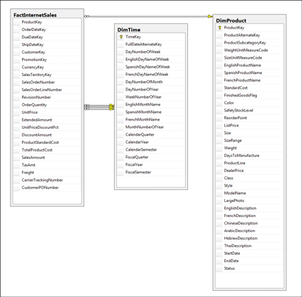

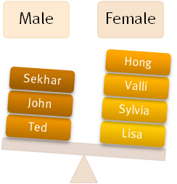
When Do You Partition?
When you have a large fact table
Experiencing unsatisfactory performance
You have identifiable access patterns
Jan 2010
Dec 2009
Feb 2010
Mar 2010
Feb 2011
Apr 2010
May 2010
Jun 2010
Jul 2010
Aug 2010
Sep 2010
Oct 2010
Nov 2010
Dec 2010
Jan 2011
You need to maintain rolling data
Data can be divided into equal parts based on a column
Notes:
There are several reasons why you would partition your data:
Large fact table – Large fact tables are good candidates for table partitioning. If you have billions of rows in a table, you will see performance benefits from breaking that data up into smaller chunks. For smaller tables, avoid partitioning.
Unsatisfactory performance – As with any performance tuning initiative, a table should be partitioned only if queries against that table are producing slower response times than desired.
Identifiable access patterns – Examine the WHERE clauses of your query workload and look for table columns that are consistently used to access data. For example, if most of your queries look up records by date, then date range based partitioning design might be beneficial.
Maintaining rolling data – as discussed earlier, partitioning provides great ILM benefits.
Dividing data into equal parts – Choose a partitioning criteria that will divide your data as evenly as possible. For example, by dividing a large table into 10 partitions of equal size, you should see a 10x speedup for queres having predicates which restrict them to scanning a single partition.

Slide 9
Partitioned Table Design
sales
trans_id bigint PRIMARY KEY
date date
amount decimal(9,2)
region text
Parent table
jan08
feb08
mar08
date ≥ 01-01-2008
date ≤ 01-31-2008
date ≥ 02-01-2008
date ≤ 02-28-2008
date ≥ 03-01-2008
date ≤ 03-31-2008
Range partition by date
Notes:
When you partition a table in Greenplum Database, you:
Create a top-level or parent-level table
Create one or more levels of sub-tables, or child tables. (CAVEAT: Avoid multi-level partitioning)
Can insert data into the parent table, or direclty into the child partition.
Actually store data only at the lowest level of the table.

Slide 10
Creating Partitioned Tables
A table …
Can be partitioned only at creation time
Can be partitioned with the command, CREATE TABLE
Can be subpartitioned into additional levels
Can be partitioned using the following partition designs:
Date range
Numeric range
List
Notes:
A table can only be partitioned at creation time using the CREATE TABLE command.
The first step in partitioning a table is to decide on the partition design (date range, numeric range, or list of values) and choose the column on which to partition the table.
You can partition a table using:
A date range
A numeric range
A list

Slide 11


Creating a Range Partitioned Table
Example: Creating a partitioned table with date range table partitions
Use CREATE TABLE to create partitioned tables.
CREATE TABLE sales (id int, date date, amt decimal(10,2))
DISTRIBUTED BY (id)
PARTITION BY RANGE (date)
( PARTITION Jan08 START (date '2008-01-01') INCLUSIVE ,
PARTITION Feb08 START (date '2008-02-01') INCLUSIVE ,
PARTITION Mar08 START (date '2008-03-01') INCLUSIVE ,
…
PARTITION Dec08 START (date '2008-12-01') INCLUSIVE
END (date '2009-01-01') EXCLUSIVE );
Notes:
You can define a date range or a numeric range for a partitioned table:
A date range uses a single date or timestamp column as the partition key column.
When date partitioning a table, consider partitioning by the most granular level you are interested in. For example, partition by day and have 365 daily partitions, rather than partitioning by year, then subpartitioning by month, then subpartitioning by day.
You can have Greenplum Database automatically generate partitions by giving a START value, an END value, and an EVERY clause that defines the partition increment value. By default, START values are always inclusive and END values are always exclusive. Note: You can declare and name each partition individually.

Slide 12
Creating a Range Partitioned Table (Cont’d.)
Example: Creating a partition table with numeric range table partitions
Use CREATE TABLE to create partitioned tables.
CREATE TABLE ranking (id int, rank int, year int, gender char(1), count int)
DISTRIBUTED BY (id)
PARTITION BY RANGE (year)
( START (2001) END (2008) EVERY (1),
DEFAULT PARTITION extra );
Notes:
A numeric range uses a single numeric data type column as the partition key column
Caveat: avoid using DEFAULT PARTITION, because it is always scanned, and in certain cases can contain far more data than expected.
In some cases, your default partition can contain *all* your data, which isn't desirable.

Slide 13
Creating a Range Partitioned Table (Cont’d.)
ranking
id int
rank int
year int
gender char
count int
ranking_1_prt_1
ranking_1_prt_8
ranking_1_prt_extra
year ≥ 01-01-2001
year ≤ 12-31-2001
year ≥ 01-01-2008
year ≤ 12-31-2008
year ≥ 01-01-2009 OR
year ≤ 12-31-2000
Notes:
The child tables created are created with the name, ranking_1_prt_#, where # represents the sequential number assigned to the table. In this example, the first child table created for the year 2001 is assigned the name, ranking_1_prt_1, while the last child table created is ranking_1_prt_8.
The default child table created is ranking_1_prt_extra, due to the “DEFAULT PARTITION extra” in the table definition (previous slide).

Slide 14
Creating a List Partitioned Table
Example: Creating a partition table with list
The following is an example of a list partitioned table:
CREATE TABLE ranking (id int, rank int, year int, gender char(1), count int )
DISTRIBUTED BY (id)
PARTITION BY LIST (gender)
( PARTITION girls VALUES ('F'),
PARTITION boys VALUES ('M'),
DEFAULT PARTITION other );
Notes:
A list partitioned table:
Can use any data type column that allows equality comparisons as its partition key column.
Can have a multi-column, or composite, partition key, while a range partition only allows a single column as the partition key.
Requires you declare a partition specification for every partition, or list value, you want to create.

Slide 15
Creating a List Partitioned Table (Cont’d.)
ranking
id int
rank int
year int
gender char
count int
ranking_1_prt_girls
ranking_1_prt_boys
ranking_1_prt_other
gender=‘F’
gender=‘B’
gender!=‘B’ and gender != ‘G’
Notes:
For the example provided, each list was assigned a specific name for a specific value. All entries not defined will be assigned to the default table.

Slide 16
Partitioning an Existing Table
When working with an existing table:
You cannot partition the table once it’s been created
You can create a new partitioned table and migrate your data
Notes:
It is not possible to partition a table that has already been created. Tables can only be partitioned at CREATE TABLE time.
To partition an existing table, you must:
Recreate the table as a partitioned table.
Reload the data into the newly partitioned table.
Drop the original table and rename the partitioned table to the original name.
Grant any table permissions to the new table that were granted on the original table.

Slide 17
Partitioning an Existing Table (Cont’d.)
Example: How to partition an existing table
CREATE TABLE sales2 (LIKE sales)
PARTITION BY RANGE (date)
( START (date '2008-01-01') INCLUSIVE
END (date '2009-01-01') EXCLUSIVE
EVERY (INTERVAL '1 month') );
INSERT INTO sales2 SELECT * FROM sales;
DROP TABLE sales;
ALTER TABLE sales2 RENAME TO sales;
GRANT ALL PRIVILEGES ON sales TO admin;
GRANT SELECT ON sales TO guest;
Notes:
This example highlights one method of partitioning an existing table. To perform this action, a second table is created based on the definition of the table to be partitioned. While creating the table, you define the partitioning scheme for the table which, in this case, is based on a date range.
Once the table has been created, insert data from the existing table into the newly created and partitioned table.
Next, drop the original table and change the name of the new table to the name of the original table and grant all appropriate privileges for the table.

Slide 18

Maintaining Partitioned Tables
Use ALTER TABLE to:
Example: Add a partition to an existing partitioned table
ALTER TABLE sales ADD PARTITION
START (date '2009-02-01') INCLUSIVE
END (date '2009-03-01') EXCLUSIVE;
Example: Rename a partition
ALTER TABLE sales RENAME TO globalsales; ALTER TABLE sales RENAME PARTITION FOR ('2008-01-01') TO jan08;
Example: Add a default partition
ALTER TABLE sales ADD DEFAULT PARTITION other;
Notes:
You maintain a partitioned table using the ALTER TABLE command to:
Add a partition to an existing partition design. You can:
Add a partition to a table that already has subpartitions defined using the ADD PARTITION clause
Add a partition to a table that does not have subpartition templates defined using the ADD PARTITION clause followed by the SUBPARTITION statements
Add a subpartition using ALTER PARTITION FOR (…) ADD PARTITION …
Rename a partition by renaming the top-level parent table to update the child table created or by renaming the partition directly.
Add a default partition to an existing partition design. If the partition design is multi-level, you must define a partition default for each level.
Caveat: as before on default partition

Slide 19
Maintaining Partitioned Tables (Cont’d.)
Example: Remove a partition
ALTER TABLE sales DROP PARTITION FOR (RANK(1));
Example: Truncate a partition
ALTER TABLE sales TRUNCATE PARTITION FOR (RANK(1));
Example: Exchange a partition
CREATE TABLE jan08 (LIKE sales) WITH (appendonly=true);
INSERT INTO jan08 SELECT * FROM sales_1_prt_1 ;
ALTER TABLE sales EXCHANGE PARTITION FOR ('2008-01-01') WITH TABLE jan08;
Example: Split an existing partition in a partitioned table
ALTER TABLE sales SPLIT PARTITION FOR ('2008-01-01')
AT ('2008-01-16')
INTO (PARTITION jan081to15, PARTITION jan0816to31);
Notes:
Drop a partition using the DROP PARTITION clause. When you drop a partition that has subpartitions, the subpartitions are automatically dropped.
Truncate a partition using the TRUNCATE PARTITION clause. When you truncate a partition that has subpartitions, the subpartitions are automatically truncated.
Exchange a partition using the EXCHANGE PARTITION FOR clause. Exchanging a partition involves swapping in another table in place of an existing partition. You can only exchange partitions at the lowest level of the partition hierarchy.
Split a partition using the INTO clause. Splitting a partition involves dividing an existing partition into two. You can only split partitions at the lowest level of the partition hierarchy. The value specified in the ‘AT …’ clause determines the starting point for the data going into the new partition.

Slide 20
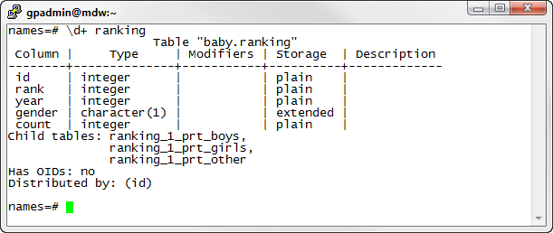
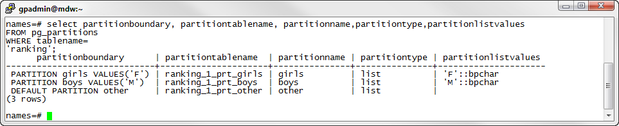
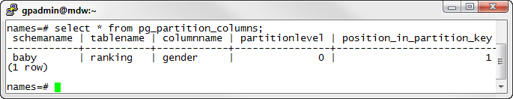
Viewing Details on Partitioned Tables
Details on the parent and child tables
pg_partitions view lets you obtain more details on partitioned tables
pg_partition_columns displays the column used for partitioning
Notes:
Some partition information can be obtained by using the \d+ PSQL meta-command. All child tables are displayed by their names.
You can obtain additional information from the pg_partitions view.
The pg_partition_columns view displays the column used for partitioning.

Slide 21
Using PQO With Partitioned Tables
Pivotal Query Optimizer requires statistics on the root partition of partitioned tables
gpconfig -c optimizer_analyze_root_partition -v on –masteronly
OR
ANALYZE ROOTPARTITION;
Notes:
Keep this in mind when using partitioned tables with Pivotal Query Optimizer
Either set this configuration parameter
Or,
Use ANALYZE ROOTPARTITION when analyzing partitioned tables

Slide 22
Review
What is table partitioning?
Two methods of partitioning
Why partition?
Steps to partition a table
Test it out in the lab
Notes:
Never distribute and partition tables on the same column.
Using EXPLAIN to validate that partitions are being eliminated.
Avoid multi-level partitioning, and don’t partition smaller tables
Be mindful that, when partitioning columnar tables, the number of files on the filesystem increases significantly; consider 100,000 files per host as a sensible limit.
Spend some time now to review table partitioning by getting hands-on with the lab.
Thank you!

